Slide 1
Dhanalakshmi Srinivasan college of engineering & technology
TUTORIAL OF PROGRAMMING LANGUAGE
A MINI PROJECT PPT PRESENTATION
submitted by
DHANESHWAR KUMAR (310520104027)
DEEPAK KUMAR (310520104024)
in partial fulfilment for the award of the degree
of
BACHELOR OF ENGINEERING
in
COMPUTER SCIENCE AND ENGINEERING
DHANALAKSHMI SRINIVASAN COLLEGE OF ENGINEERING AND TECHNOLOGY MAMALLAPURAM
ANNA UNIVERSITY :: CHENNAI 600025

Slide 2

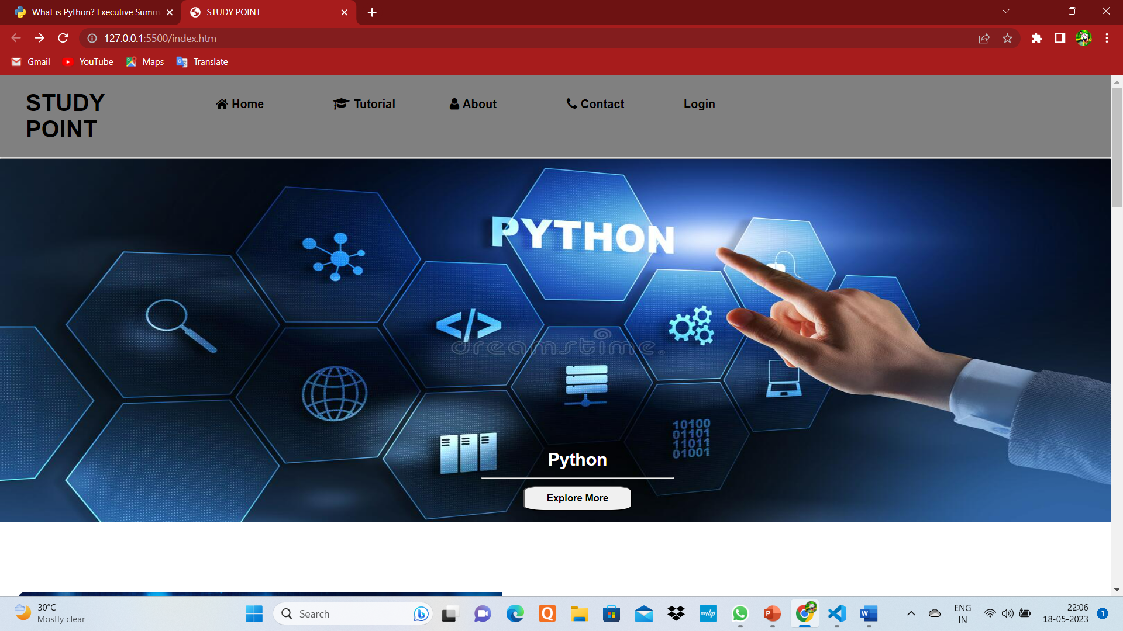
TUTORIAL OF PROGRAMMING LANGUAGES
Below pic shown by screenshort of my website
In this user interface , there are many features
Like home page, if you click on home page you will get the content of home , Tutorial – when you click the tutorial button you will see some option like DSA , WEB DOVELOPMENT AND PROGRAMMING LANGUAGE .

Slide 3

Dynamic programing
Message Authentication
Integrity
Non-Repudiation
DSA
Data structure and Algorithm (DSA) are essential building block of code
Understanding data structure’s importance can help you better grasp how your code operates and how your computer handles the enormous amount of incoming data.
INSERT LOGO HERE

Slide 4
Web development
Web development refers to the creating, building, and maintaining of website. It includes aspects such as web design, web publishing, and so on
HTML
CSS
WEB DEVELOPMENT
JAVA SCRIPT
PHP
SQL

Slide 5
PYTHON PROGRAMMING
Easy to code
Easy to read
Extensible
Free and open source
INSERT LOGO HERE

Slide 6

JAVA PROGRAMMING
Java is widely used programming language for coding web application. It has been a popular choice among developers over two decades, with millions of java applications in use today . Java is multi platform, object-oriented, and network-centric language that can be used as a platform in itself
Object-oriented
Platform independent
portable
Multi-threaded
Secure

Slide 7
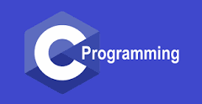



C PROGRAMMING
Function-Rich libraries
Simple and efficient
C is an imperative procedural language, supporting structured programming, lexical variable scope and recursion, with static type system.
Dynamic Memory management

Slide 8
WHICH LANGUAGE USED FOR CREATE THIS WEB APPLICATION
We have used HTML for the structure of website and CSS is used give style to make a attractive UI for the website and javaScript for the perform action on the website , we will ues php for backend and sql for store the data.
html
^{45%}
css.
^{55%}
Java script.
^{20%}
INSERT LOGO HERE

Slide 9
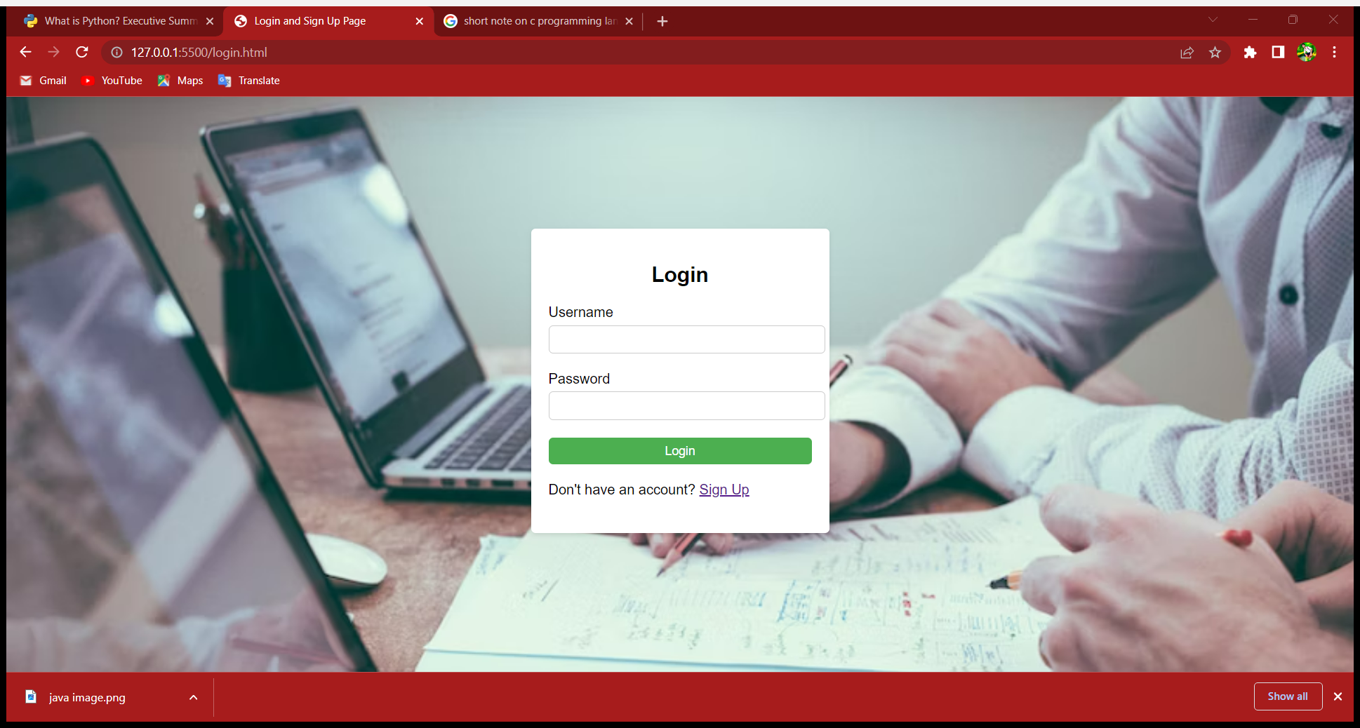
LOGIN PAGE
Notes:
You can safely remove this slide. This slide design was provided by SlideModel.com – You can download more templates, shapes and elements for PowerPoint from http://slidemodel.com

Slide 10
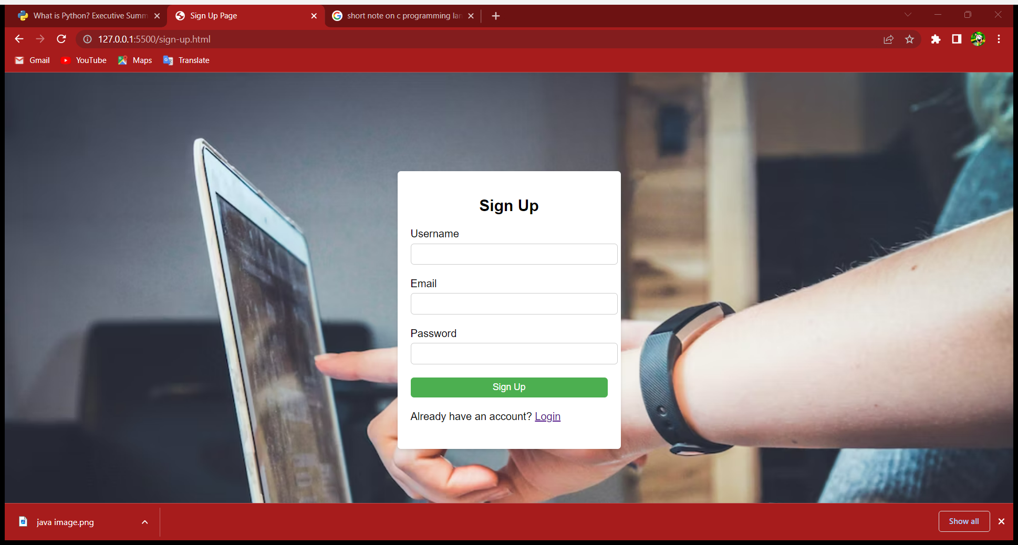
SIGN UP PAGE
Notes:
You can safely remove this slide. This slide design was provided by SlideModel.com – You can download more templates, shapes and elements for PowerPoint from http://slidemodel.com

Slide 11
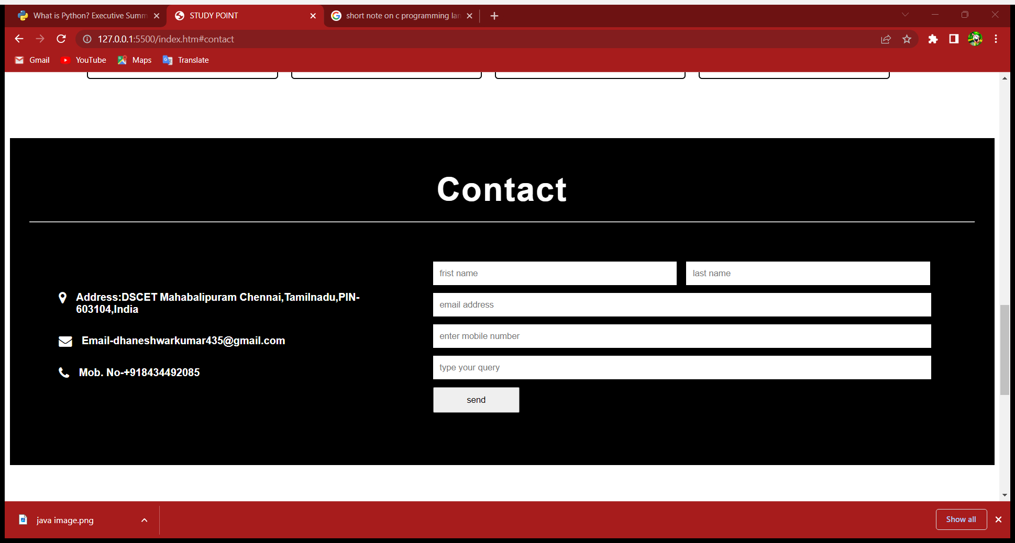
CONTACT US
Notes:
You can safely remove this slide. This slide design was provided by SlideModel.com – You can download more templates, shapes and elements for PowerPoint from http://slidemodel.com

Slide 12
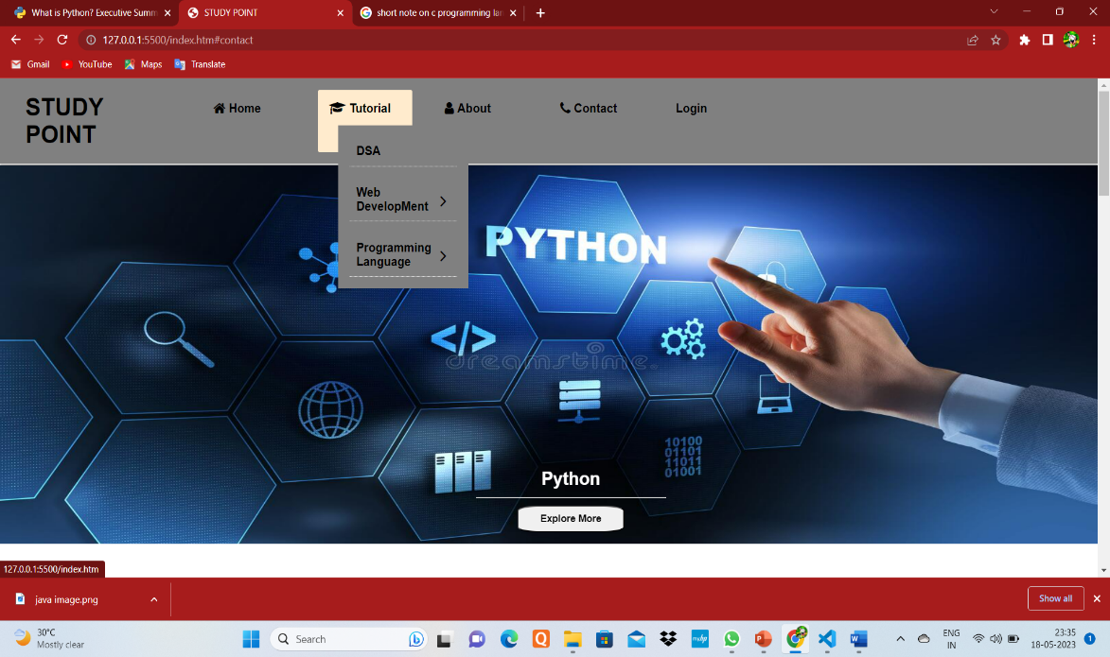
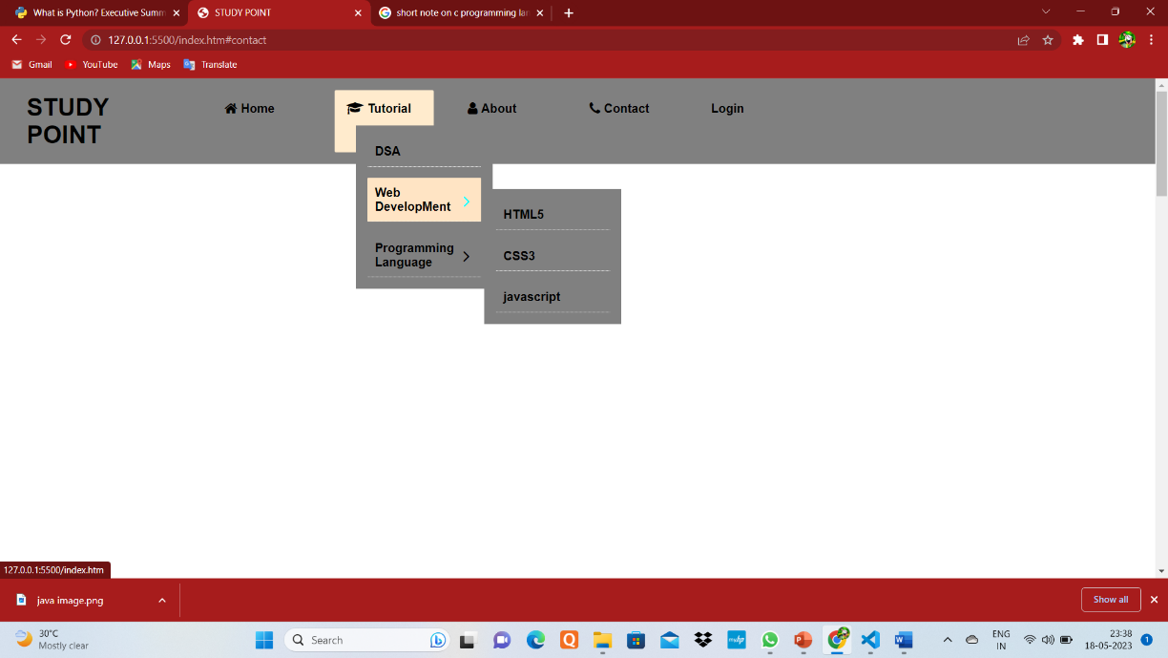
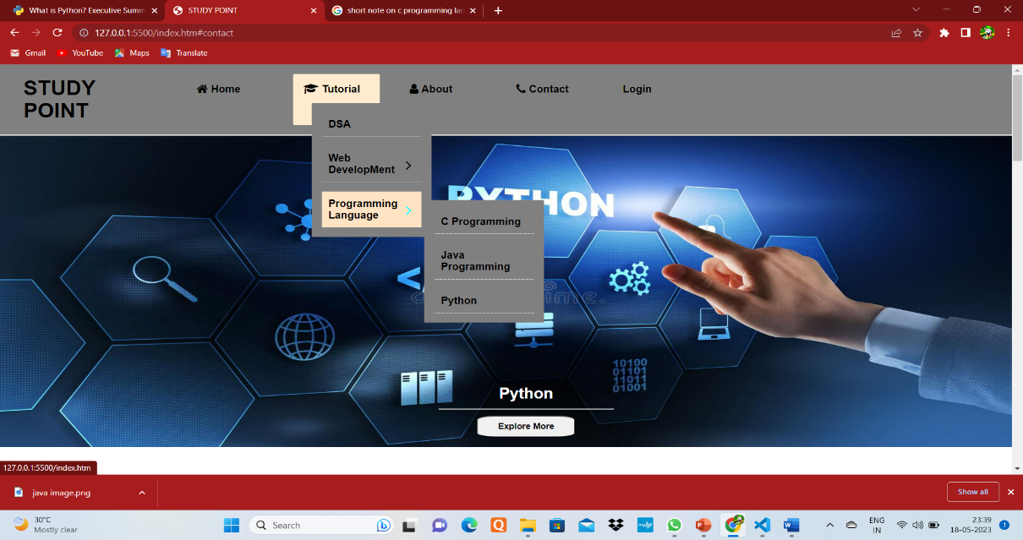
Screenshot of tutorial option
Screenshot of web development option
Screenshot of programming languages option
Notes:
You can safely remove this slide. This slide design was provided by SlideModel.com – You can download more templates, shapes and elements for PowerPoint from http://slidemodel.com

Slide 13
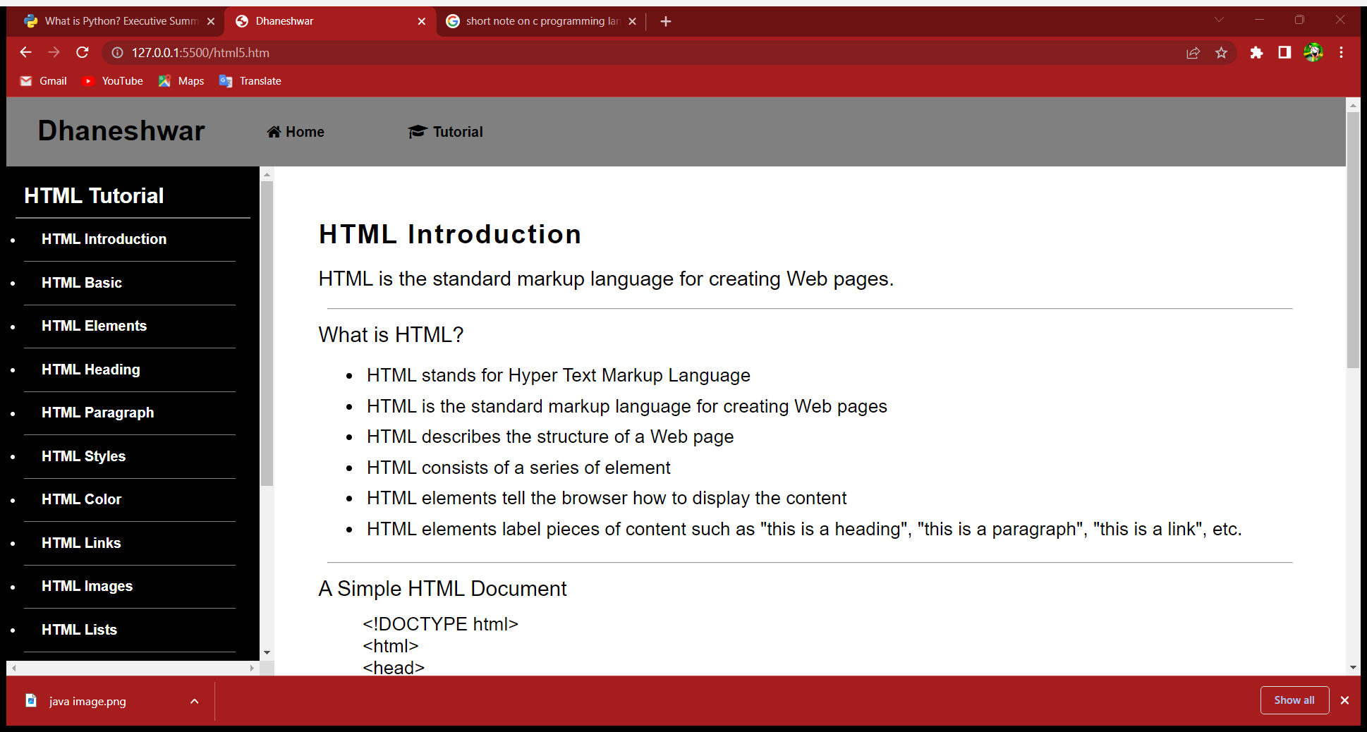
HTML TUTORIAL PAGE
Notes:
You can safely remove this slide. This slide design was provided by SlideModel.com – You can download more templates, shapes and elements for PowerPoint from http://slidemodel.com

Slide 14
OUR SOURCE CODE
Notes:
You can safely remove this slide. This slide design was provided by SlideModel.com – You can download more templates, shapes and elements for PowerPoint from http://slidemodel.com

Slide 15
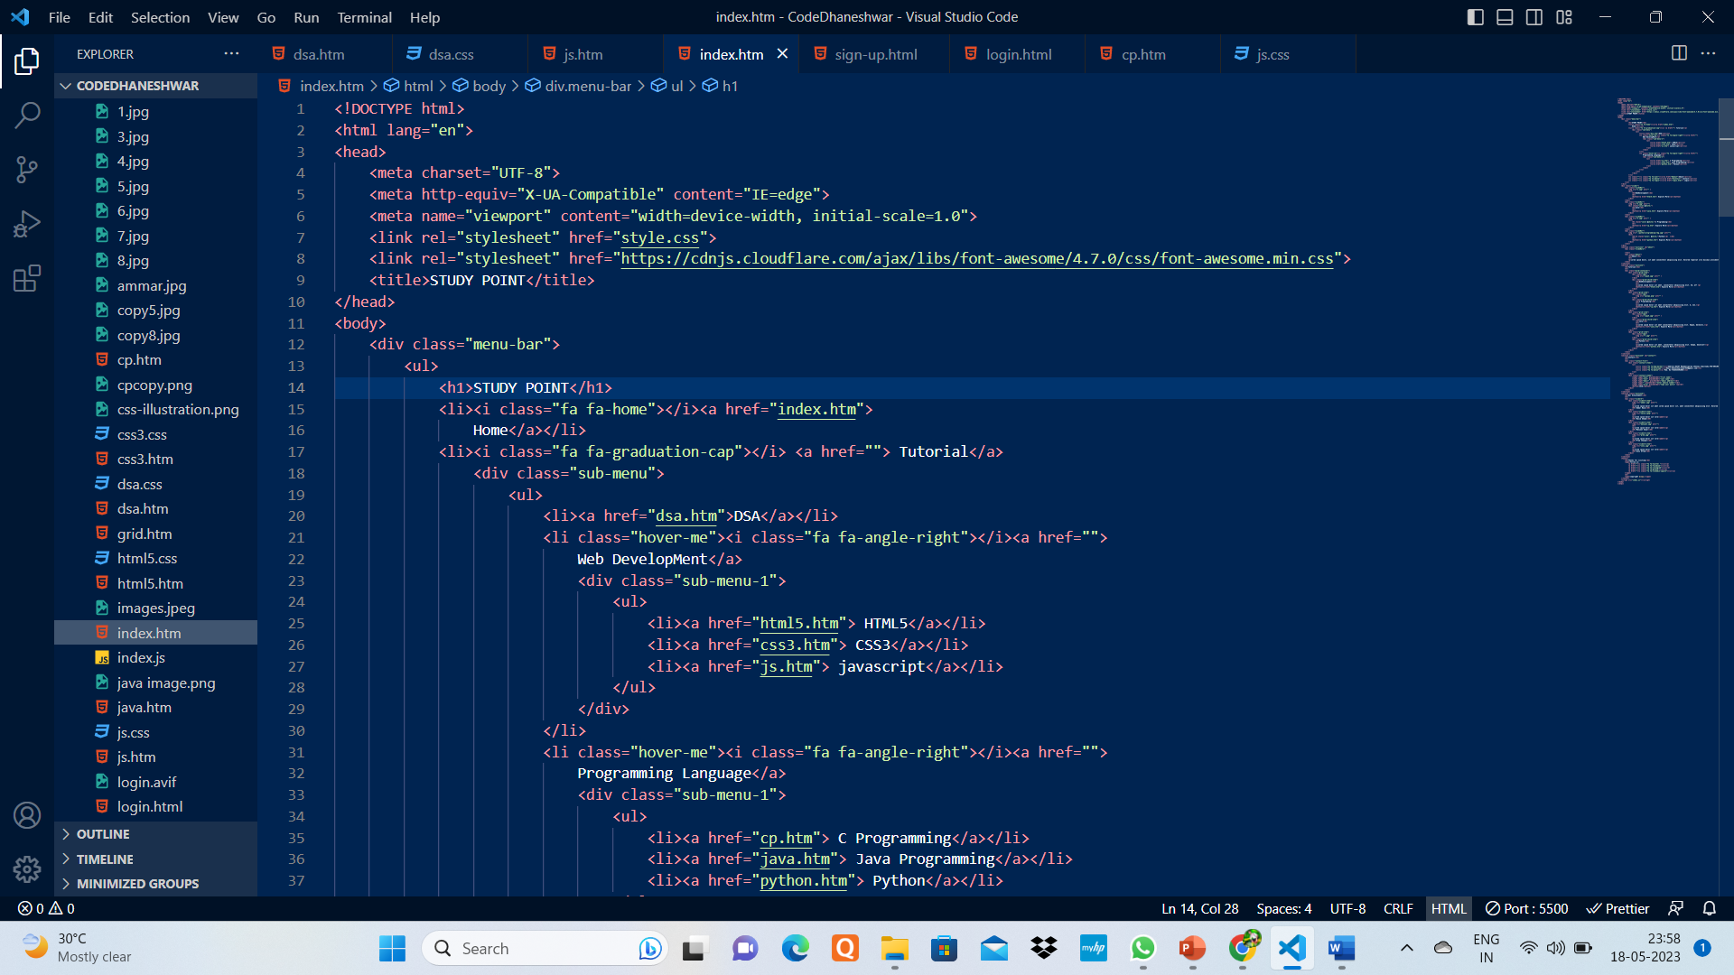
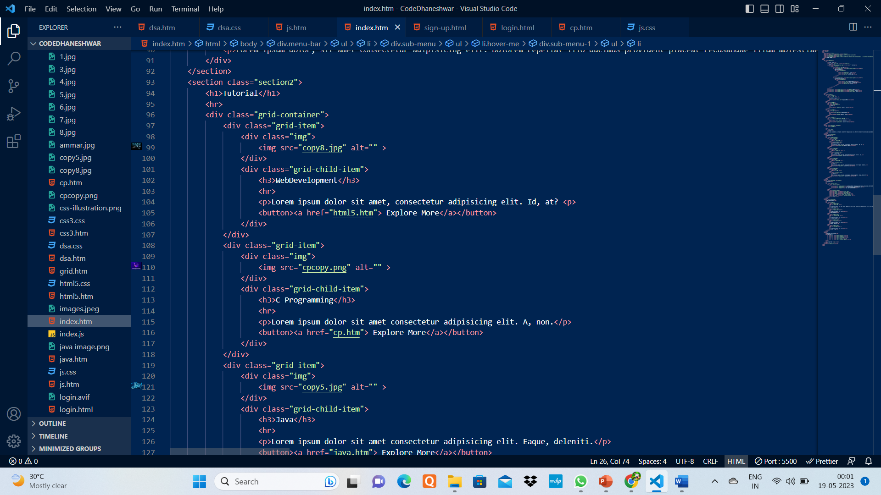
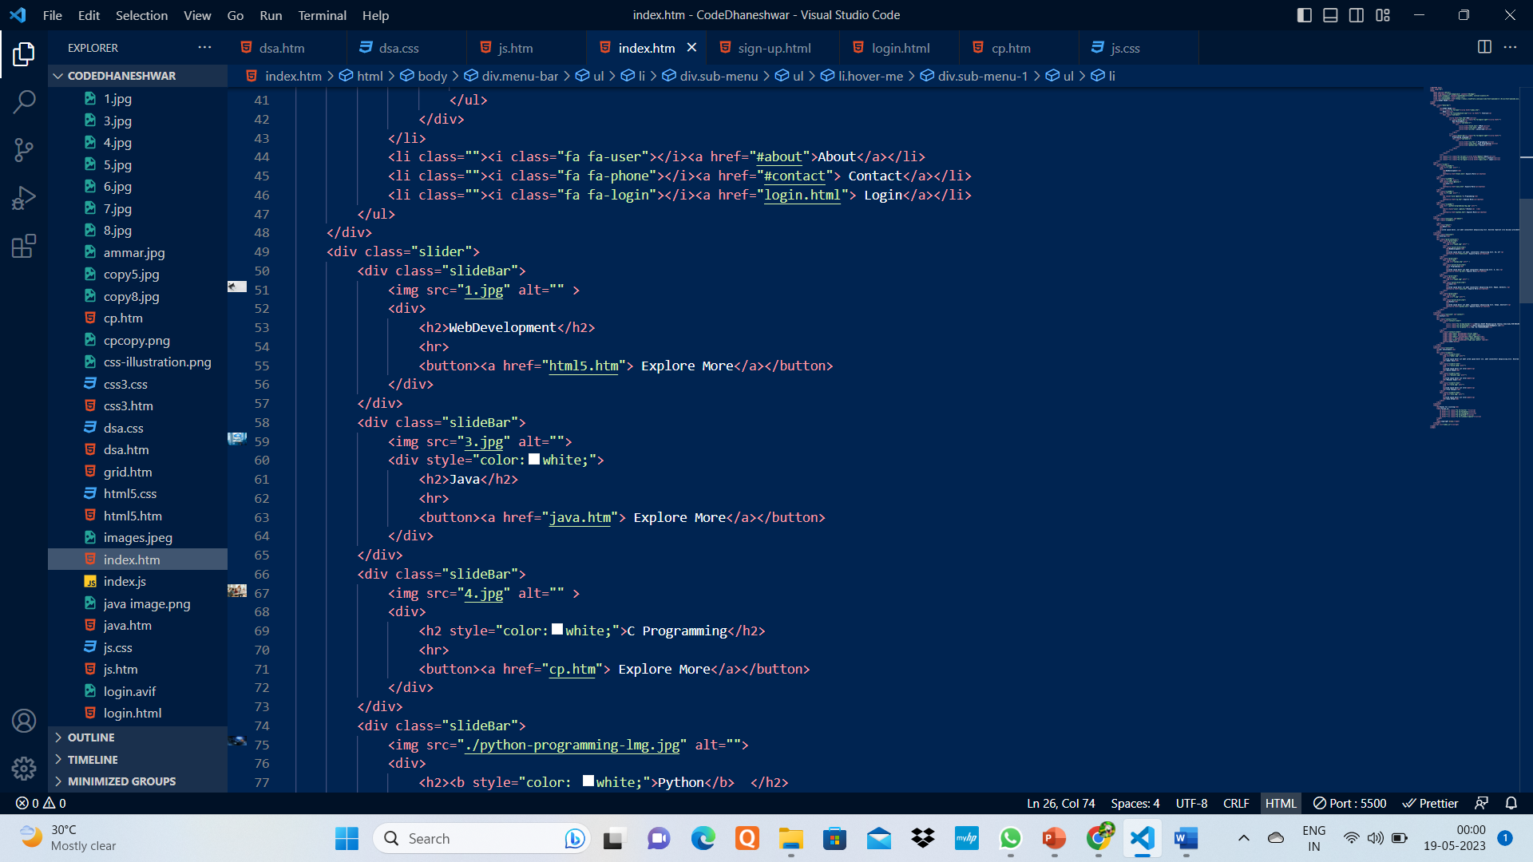

Slide 16
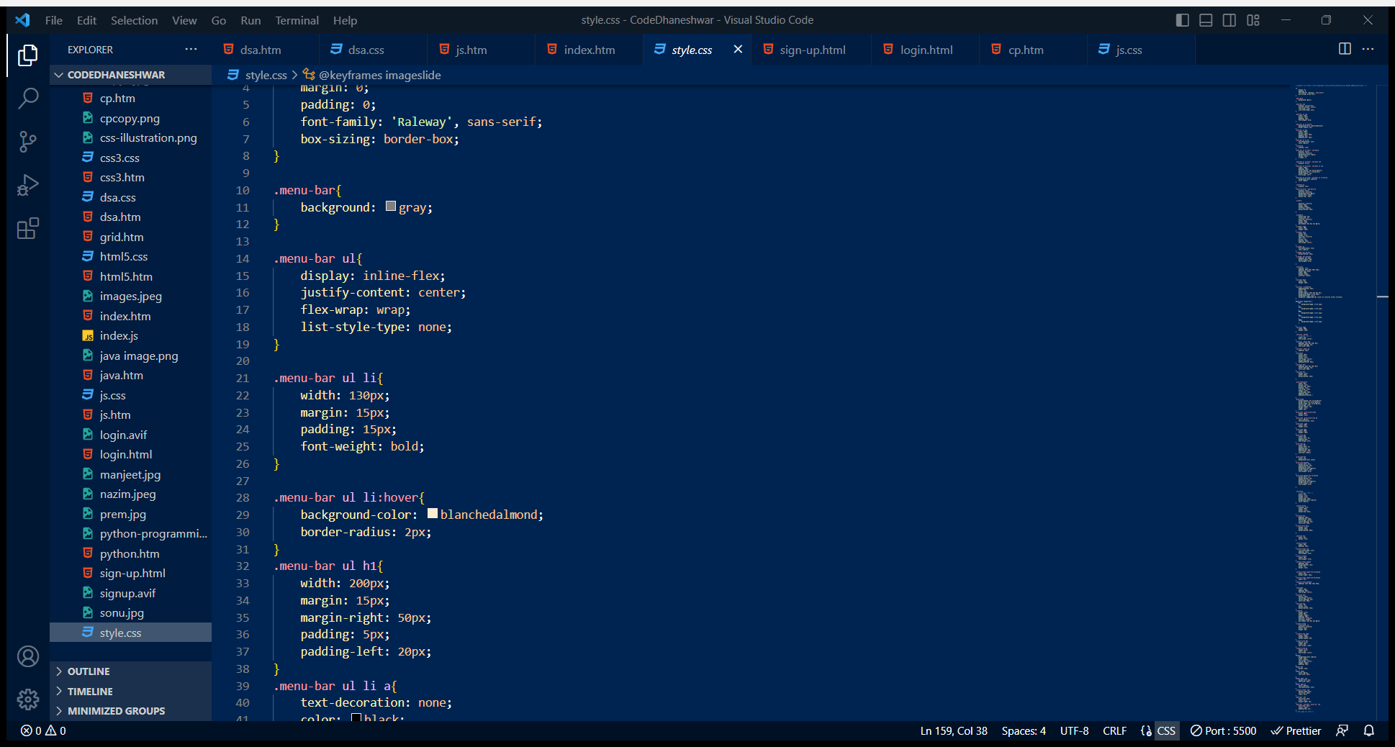
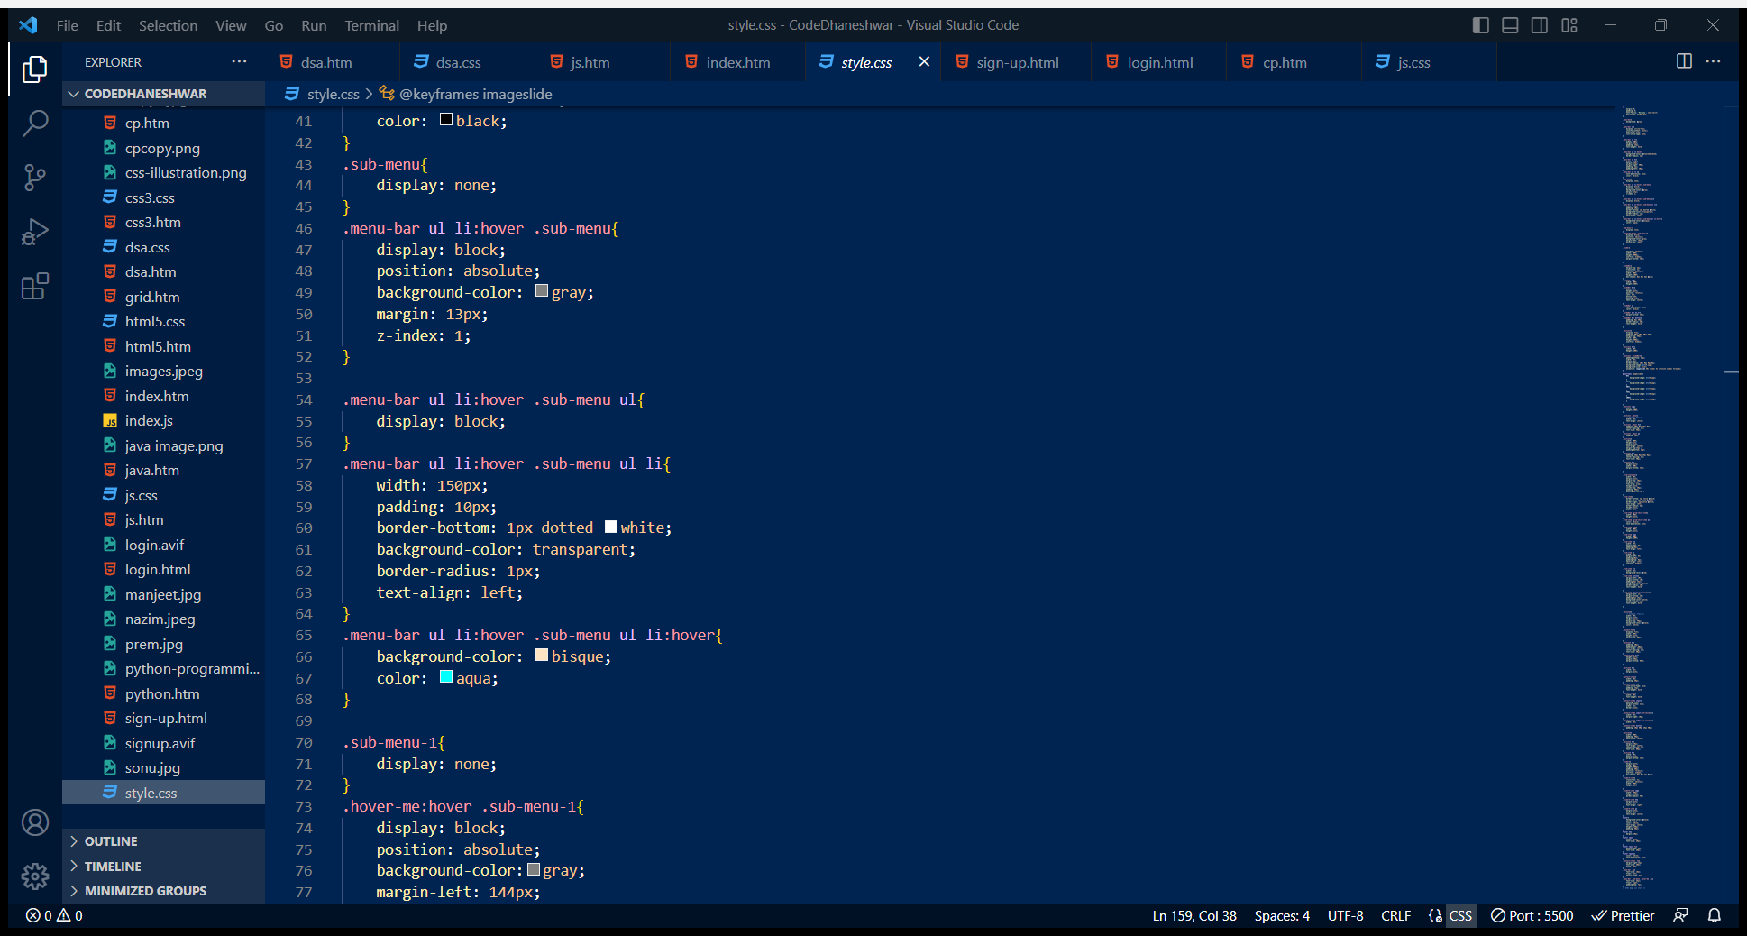

Slide 17
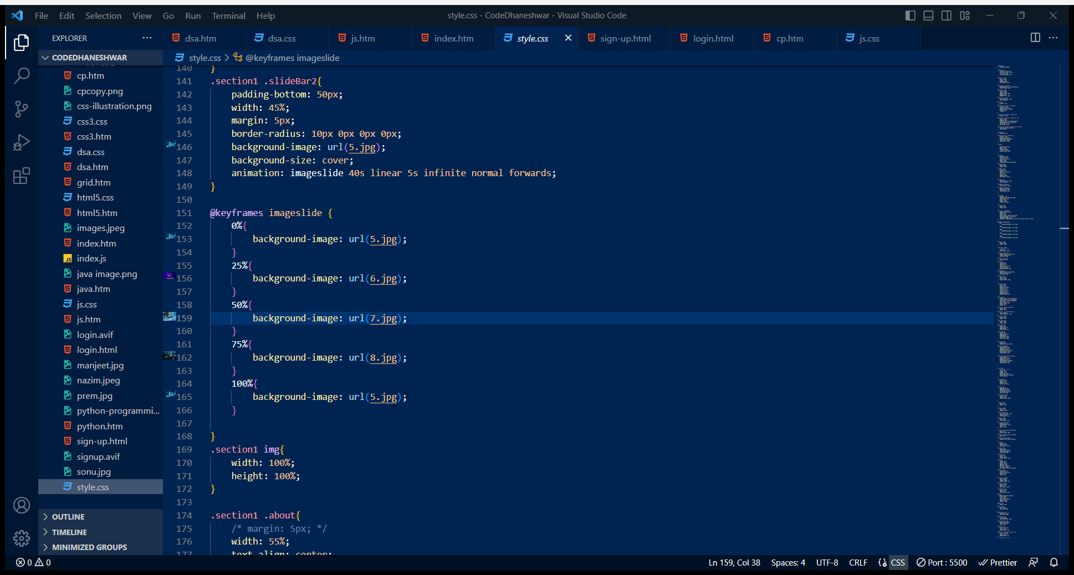
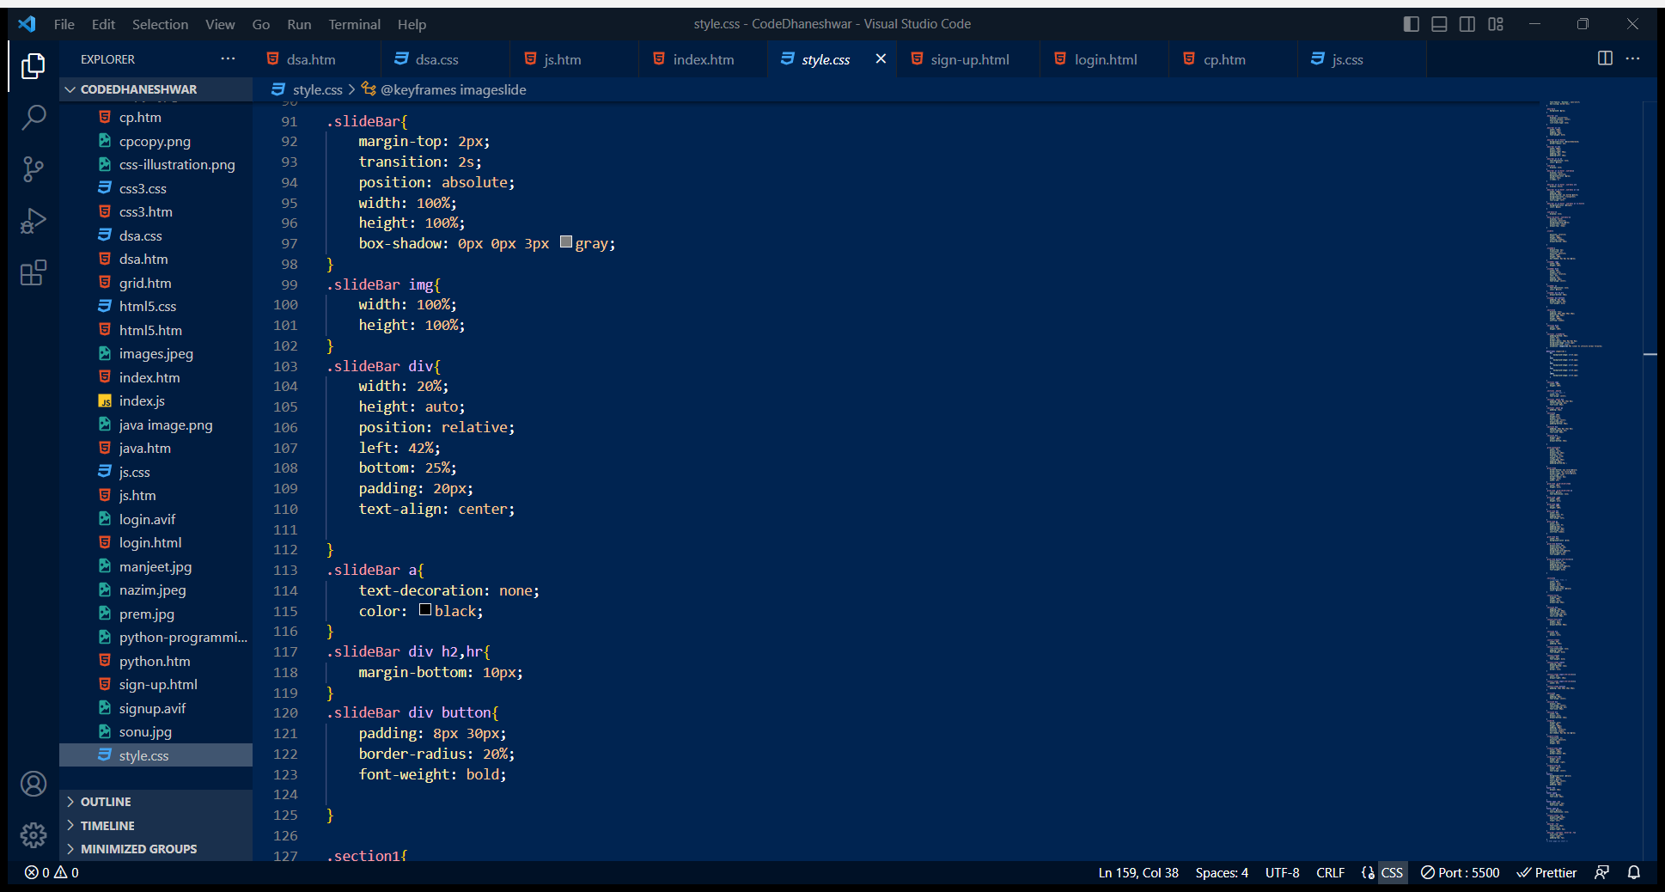

Slide 18
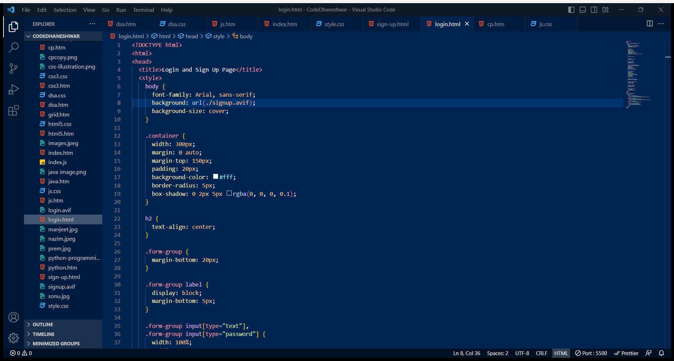
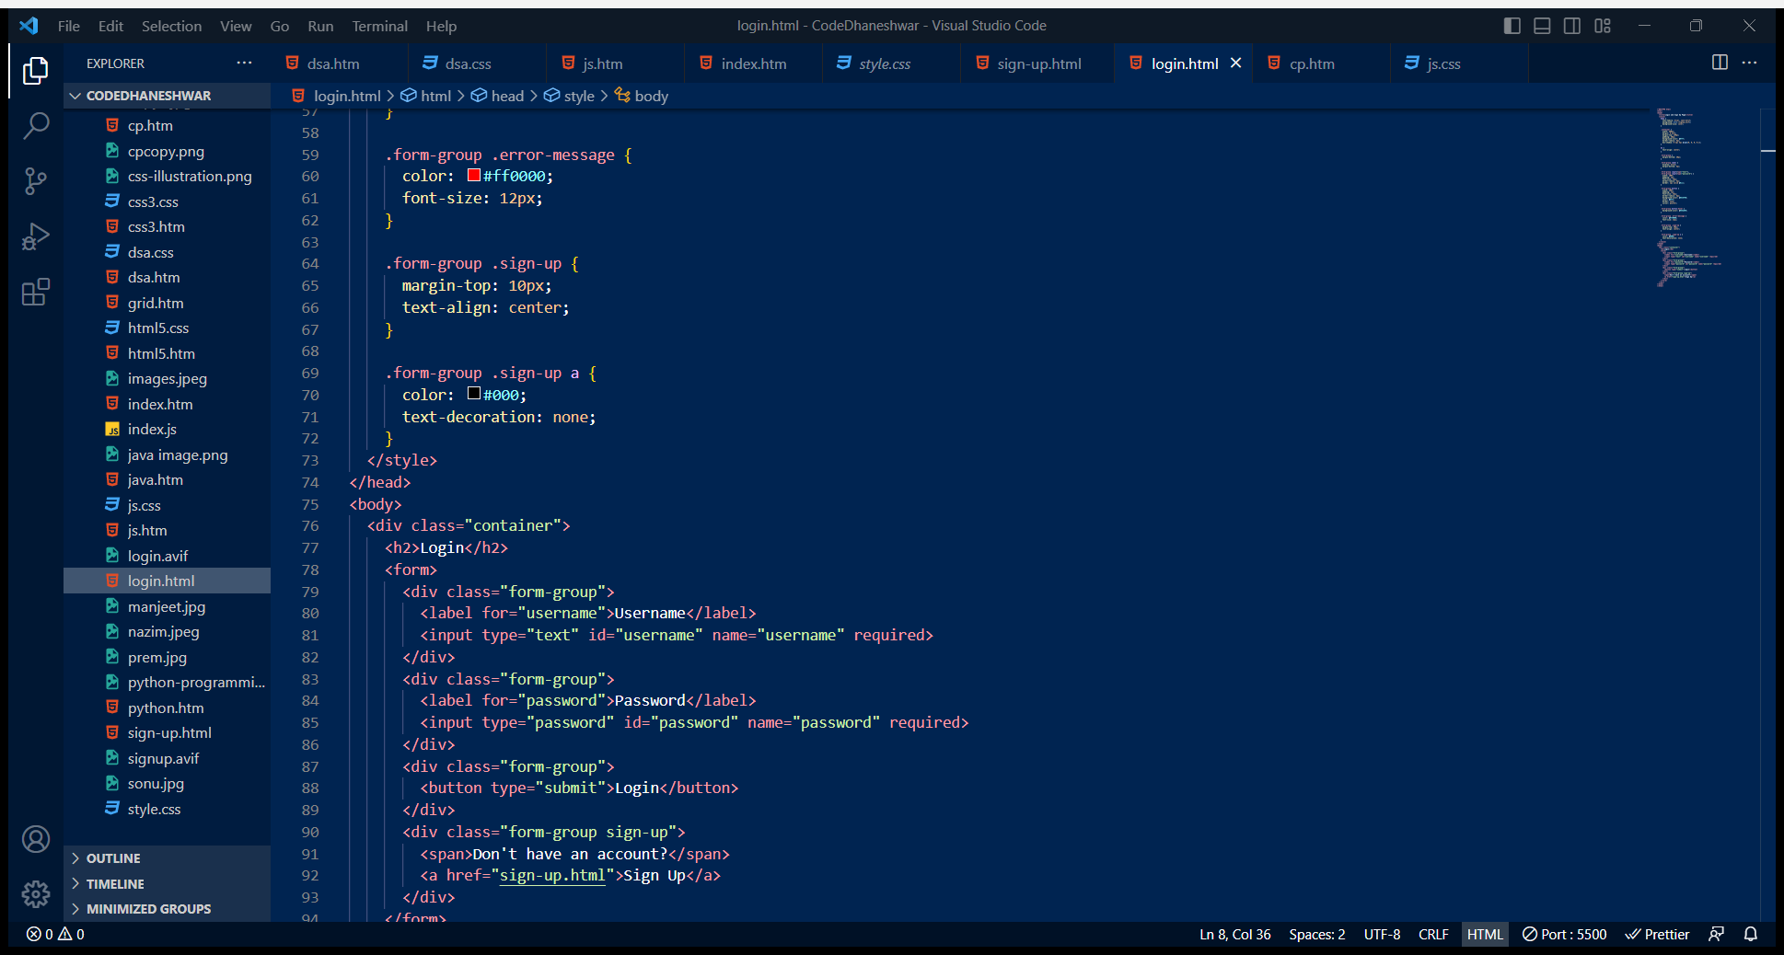
Code of login page

Slide 19
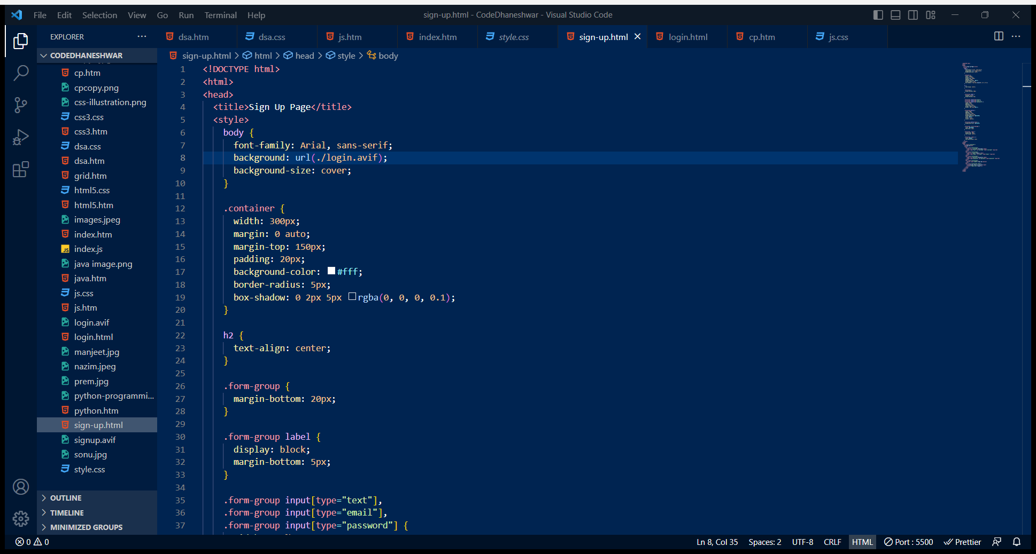
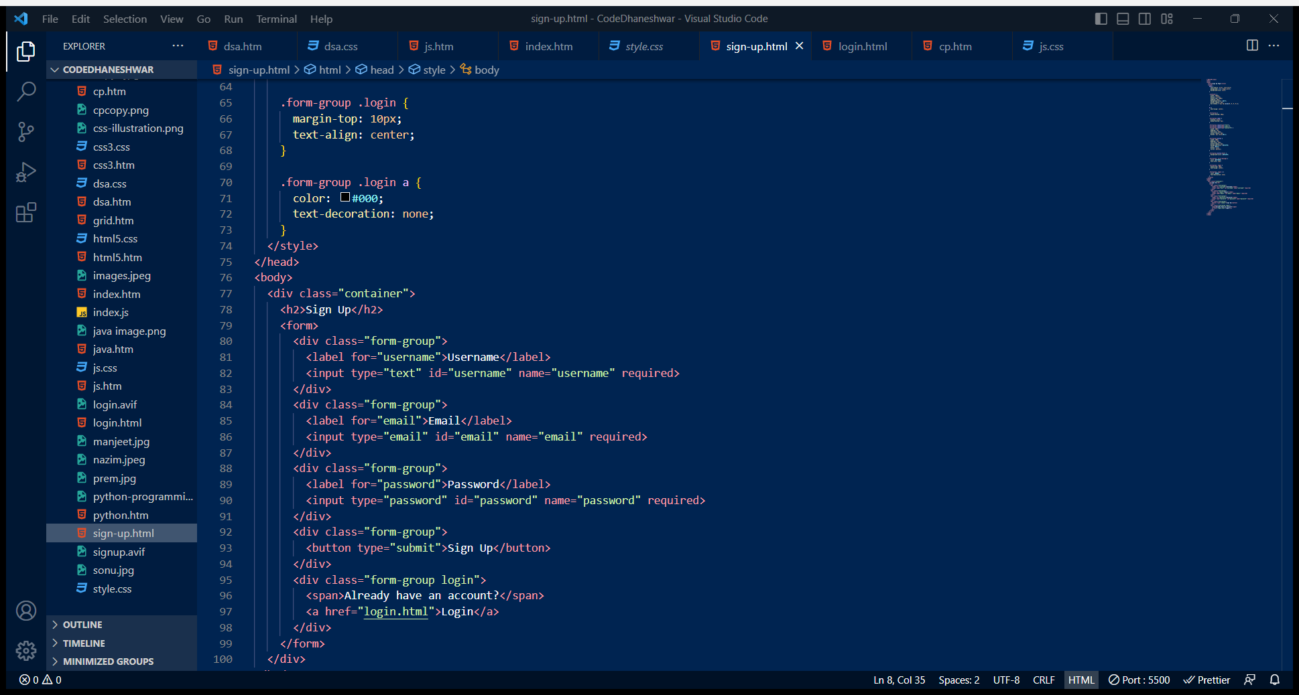
Code of Sign up page

